Slide 1
The Prophet (Allah bless him and give him peace) said, “Honesty certainly leads to goodness, and goodness leads to paradise. Truly, a man keeps speaking the truth until he is inscribed as being true through and through. And lying leads to going wrong, and going wrong leads to hell. Truly, a man lies and lies until he is inscribed as being a liar through and through” (Muslim, 4.2012–13: 2607. S).

Slide 2
Lecture 11
Javascript

Slide 3
Previous Lecture
Event Details
Node Types
Objects

Slide 4
Today’s Lecture
Objects
Introduction to Object Oriented Programming

Slide 5
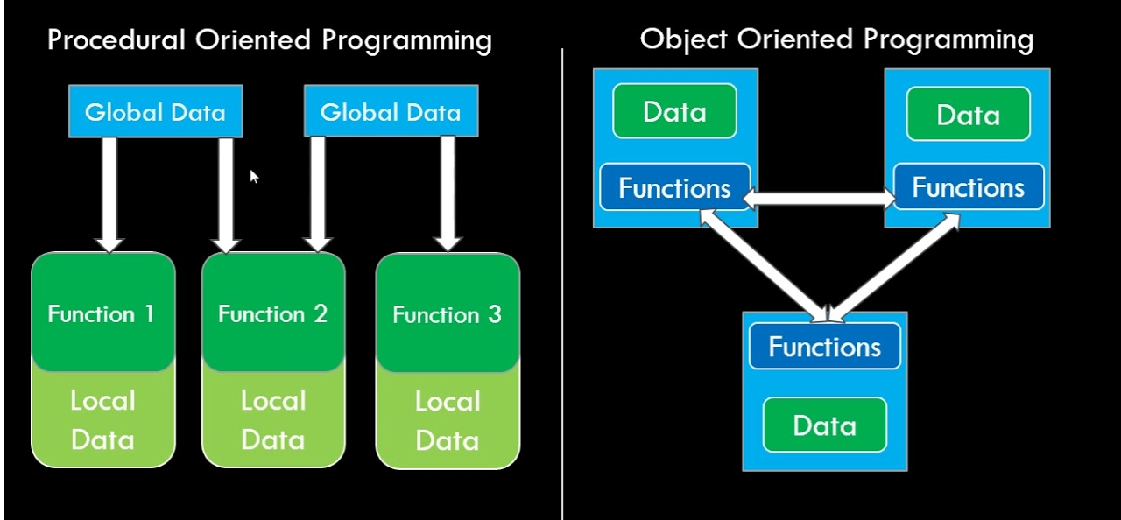
Today’s Lecture

Slide 6
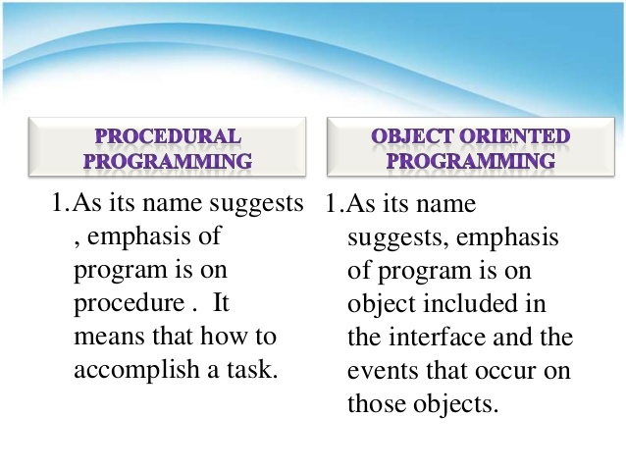
Today’s Lecture

Slide 7
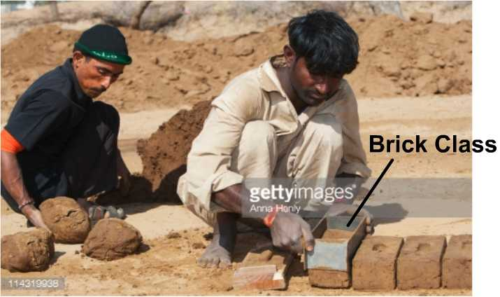
Object Oriented Programming
Maps with the real world scenarios. i.e. define a template and start getting products out of that template.

Slide 8
Objects
Object is simply a bundle of properties and functions.
Example> var myData = { name:’Khurram’, teach:function(){ //teaching code goes here } }

Slide 9
Introduction to Object Oriented Programming
Clear Module Structure
Suitable for solving real word problems

Slide 10
Modules?
Module is a self-contained piece of code which can be easily attached and detached from a software.

Slide 11
Introduction to Object Oriented Programming
function Car(){
this.model = ‘2011’;
this.wheels = ‘4’;
this.cc = 1000;
this.run = function(){ }
}
var car1 = new Car();
car1.model //2011
var car2 = new Car();
car2.model = ‘2012’;

Slide 12
Inheritance
Inheritance is how one class or template accesses the data of other class or template.

Slide 13
Prototypes
Prototype is a shared object which all instances of the class can use.
Example>
function Car(){
this.model = ‘2011’;
//this.run = function(){ //Run code goes here //} }
Car.prototype.run = function(){ Run code goes here }

Slide 14
Checking instances
function Car(){
this.model = ‘2011’; }
function Fan(){
this.wings = ‘3’; }
var c1 = new Car();
c1 instanceof Fan
//alse
c1 instanceof Car
//True

Slide 15
Constructors
Constructors returns the class or which created the instance.
function Car(){
this.model = ‘2011’; }
var c1 = new Car();
c1.constructor

Slide 16
Today’s Assignment
With the previous assignment, Add two buttons ‘Add Student’ and ‘Add Teacher’.
Note>
New objects should be create with Teacher and Student classes.
Add a new select box filled with “Teacher” and “Student”. Show All should the items according to the select box.

